Slide 1
Front End Engineering-II
Project
MUSIC PLAYER
SUBMITTED BY :-
Kanwarjeet (2210990474)
Jaskirat (2210990445)
Kshitij (2210990525)
SUBMITTED TO:
Dr. Baljit Kaur
Mr. Vikas Patel

Slide 2
Table of Contents:
Introduction
Problem Statement
Technical Details
Key Features
Project Highlights
Conclusion
References/Links Used

Slide 3
Introduction
A music player is a digital device or software application designed to play audio files.
Best way to relieve pressure in stressful modern society life.
The purpose of this project is to develop a player which can play the mainstream file format.
It stimulates emotions, fostering relaxation or energizing the listener.
Cognitive benefits include improved memory, focus, and creativity. Socially, it connects people, facilitating communication and community bonding.
Physiologically, music can reduce stress, lower blood pressure, and enhance overall well-being.

Slide 4
OVERVIEW
Meanwhile, this software can play, pause and select songs with the help of buttons according to your requirement as well as set up songs.
It serves as a convenient tool for accessing and enjoying a wide range of music content.
Whether it's stored locally on a device or streamed from online platforms, a music player provides users with the ability to create playlists, shuffle tracks, and adjust playback settings according to their preferences.
With intuitive user interfaces and features like album artwork display and customizable equalizer settings, music players offer an immersive listening experience.
From personal enjoyment to background ambiance, music players cater to diverse needs and enhance the way we engage with music.

Slide 5
Problem Statement-
Even though we have music player in our androids yet we require online streaming of songs? Why?
Problem:
Downloading each song can be pretty space consuming.
Creating albums according to our song requirements is time consuming.
Song range is limited.
Downloading songs can lead to virus threats.
Playlists created by user1 can’t be shared directly to some other user.
We cant find artists of our favourite genre
Playlist is not upto date.
Song management is not smooth

Slide 6
Technical Details-
User Interface:
Music players have graphical user interfaces (GUI) that allow users
to interact with the player.
The user interface can include features such as playlists and
visualizations.
Audio Outputs:
Music players use audio outputs such as speakers, headphones, and digital audio outputs to play back audio.

Slide 7
Technologies….
Storage Devices:
Music players can store music files on various types of storage devices such
as hard drives, solid-state drives, and memory cards.
Wireless Technologies:
Music players can connect to other devices wirelessly using technologies
such as Bluetooth and Wi-Fi.

Slide 8
Key Features-
Play, pause, and stop buttons
Progress bar
Volume control
Playlist
Album artwork display

Slide 9
JAVASCRIPT
JavaScript is a versatile programming language primarily used for web development.
It runs in web browsers, enabling dynamic interaction with web pages.
Executed on the client side, it operates within the user's browser, enabling actions such as form validation, animations, and responsive interfaces.
JavaScript interacts with the Document Object Model (DOM), to manipulate elements dynamically.
It supports event-driven programming, responding to user actions like clicks and keystrokes.
JavaScript can also communicate with web servers asynchronously, facilitating data retrieval and updates without reloading the entire page.
Its flexibility and ubiquity make it fundamental to modern web development.

Slide 10
Conclusion-
The project was a music player, which involved
designing and developing software to play audio files on web.
Key features of Music Player include -:
A user-friendly interface,
Support for different file formats,
Smooth transitions,
The ability to create and manage playlists,
Playback settings.

Slide 11
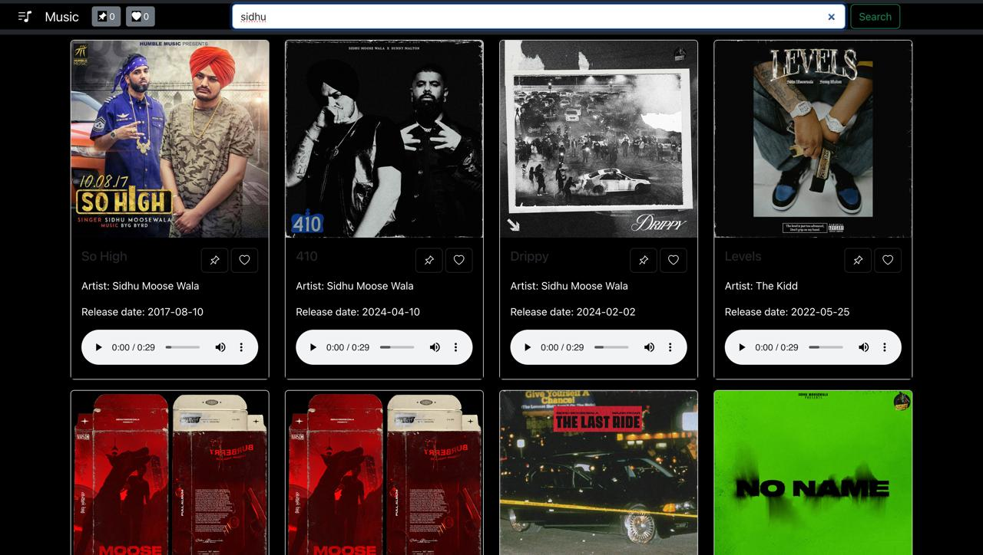

Slide 12
References/Links used
References of this project have been taken from the below mentioned sites-
https://music.youtube.com/
https://open.spotify.com/
https://www.jiosaavn.com/

Slide 13


